Slide 1
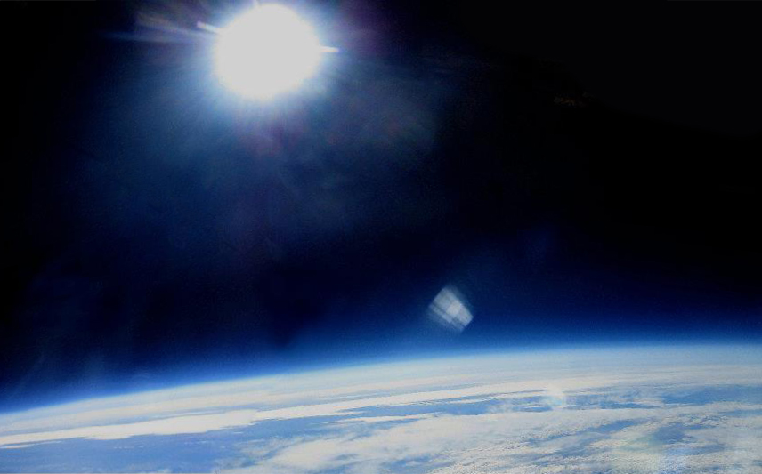
Team Members:
ASU ASCEND
2011-2012
Dr. Sharp-Advisor
Ruben Gameros-Team Lead
Christina Findley
PyePye Zaw
Darin Smith
Hallie Gengl
Jack Lightholder
Jacob Higgins
Chris Barnes
Richard Stelling
Tyler McKinney
John Gehrke

Slide 2



Overview:
Spring Structure
Fall Structure
Project: Payload Motion
Questions

Slide 3
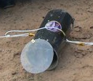
Fall Structure
Carbon fiber outside casing
Shape: cylinder with a 6 inch diameter
Polycarbonate windows to make the outside world accessible to the cameras
Components: cameras, pressure sensor, arduino

Slide 4
Spring Structure
Carbon fiber payload casing
Triangular-like shape allows for a weather vane effect, turning to the location of the least wind
drag
Aluminum casing for the cameras aligns them at 90 degree angles for stereographic imaging
A center rod connects the two pieces and allows for the rotation of the payload without twisting the rope
Components: Accelerometer, gyroscope, batteries, arduino (duemilanove & ), Baromic pressure sensor, solar cell, humidity sensor, data logger

Slide 5
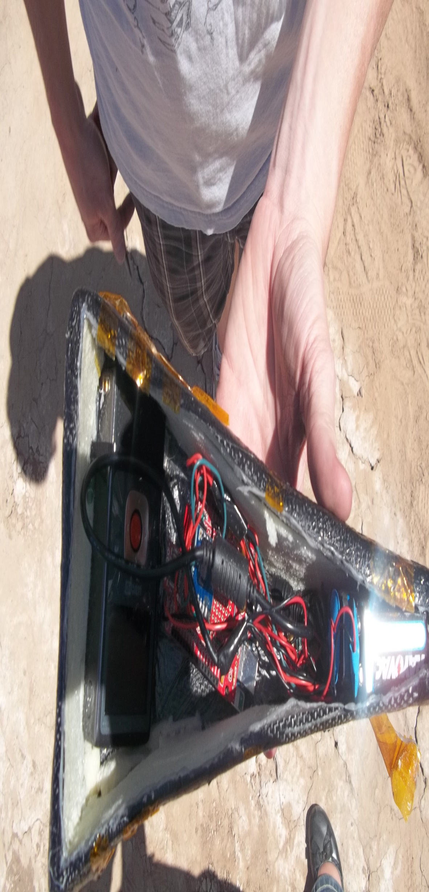
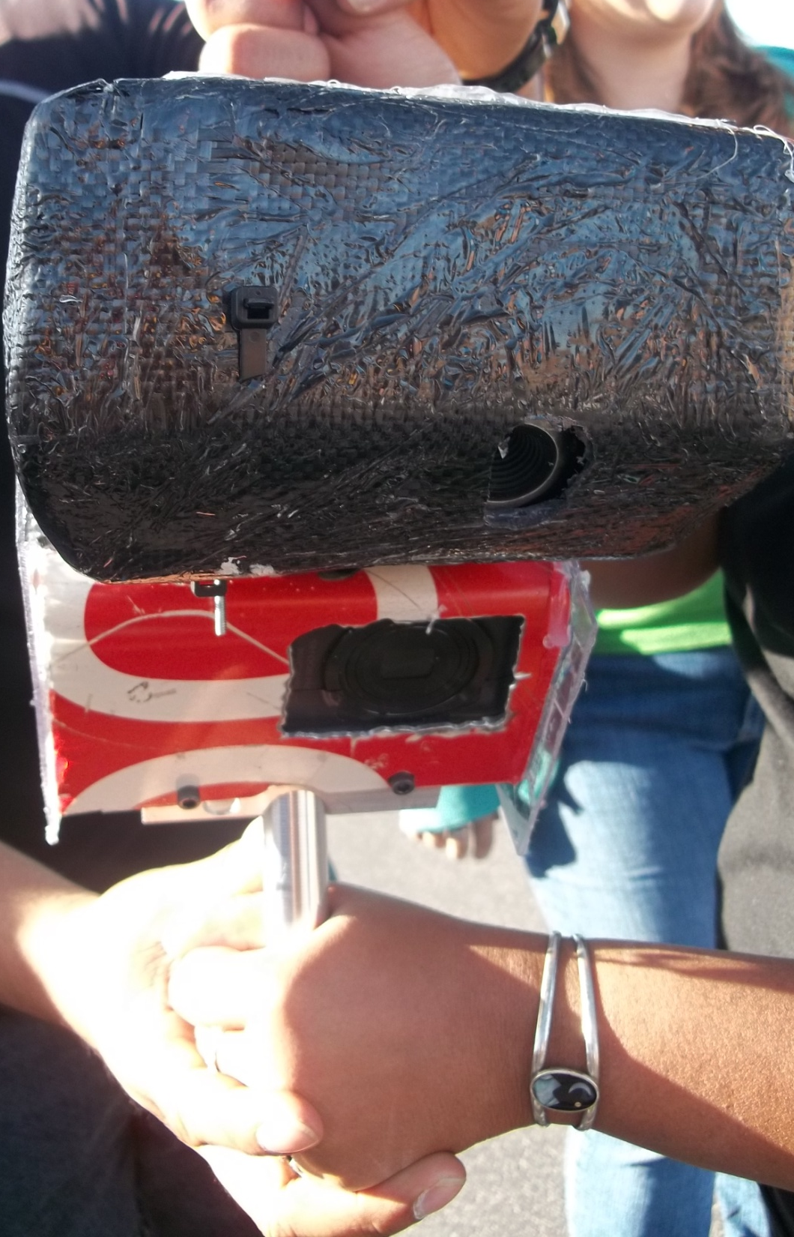

Slide 6
Payload Motion
Rotational and translation motion from accelerometer and gyroscope
Maximum accelerations in horizontal plane
Analyze the success of the weather vane effect
3D MATLAB animation: expand the understand of payload motion and future projects
Unfortunately, no data was recorded during the flight due to components overheating.
Previous ASCEND accelerometer data will be used in the program.

Slide 7
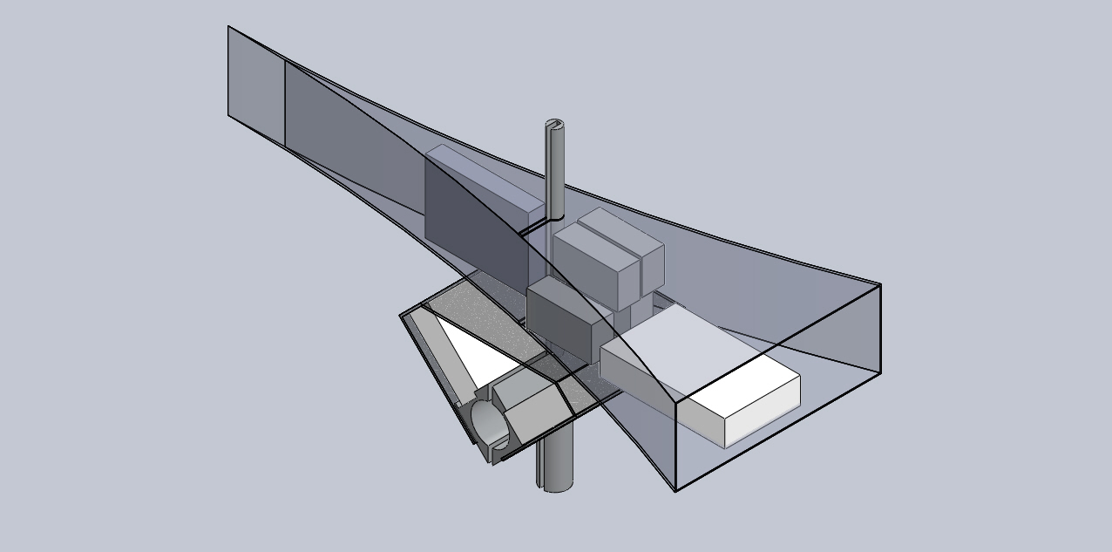
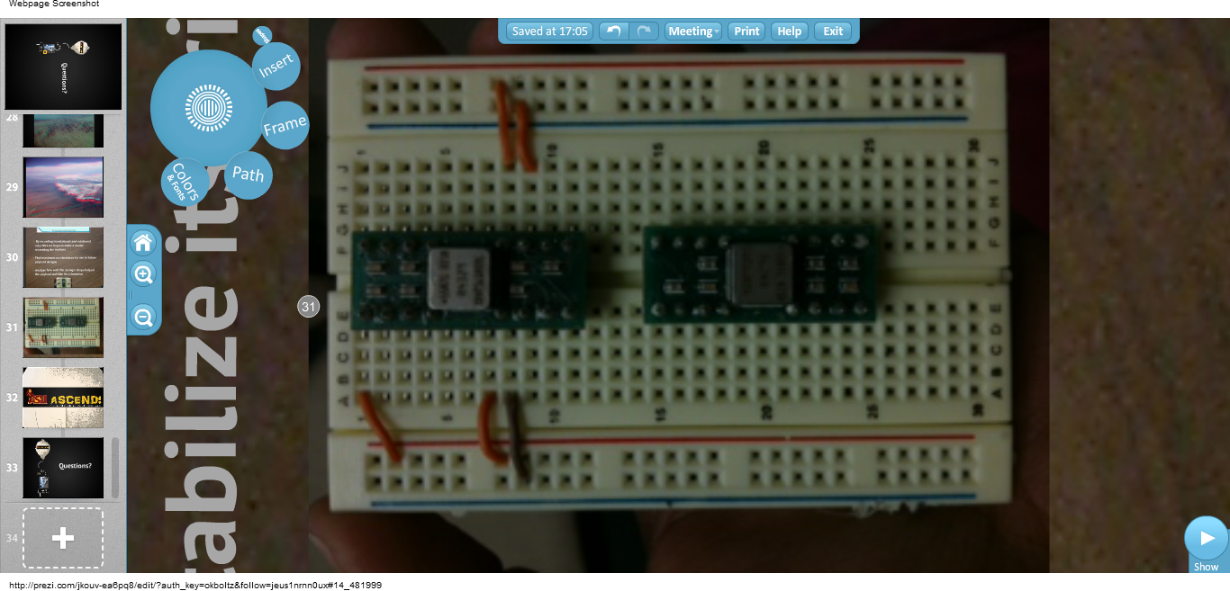

Slide 8
Questions?

